Slide 1
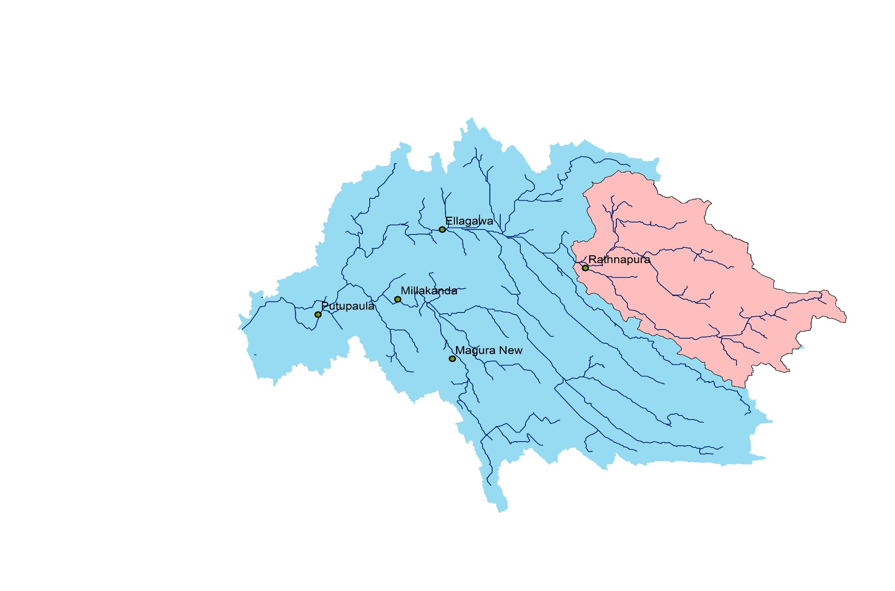
Ratnapura Catchment
Catchment Area - 642 km²
Annual Rainfall - 3150 mm

Slide 2
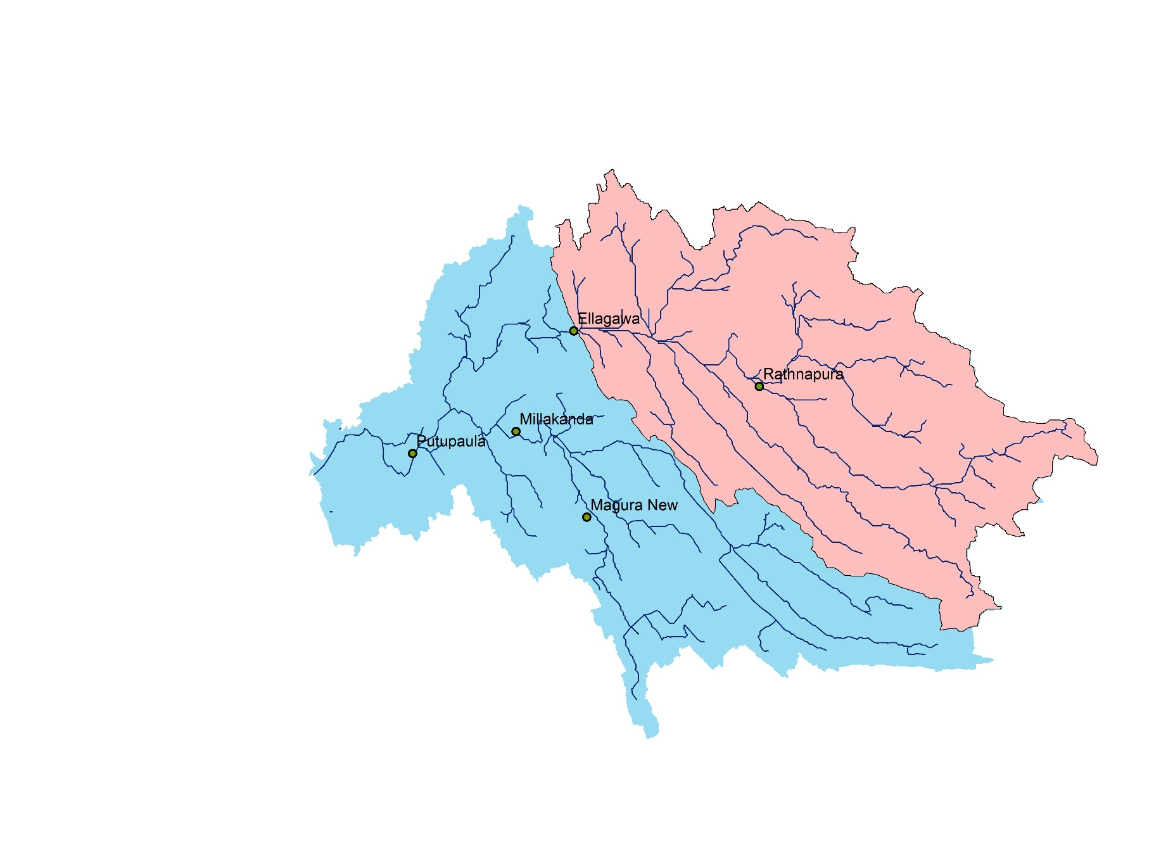
Ellagawa Catchment
Catchment Area - 1411 km²
Annual Rainfall - 3600 mm

Slide 3
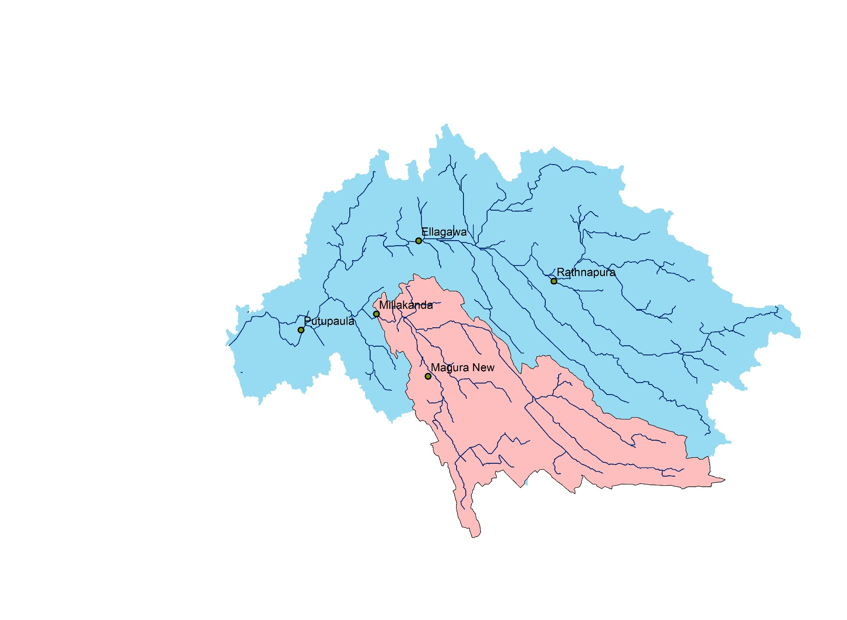
Millakanda Catchment
Catchment Area - 776 km²
Annual Rainfall - 4100 mm

Slide 4
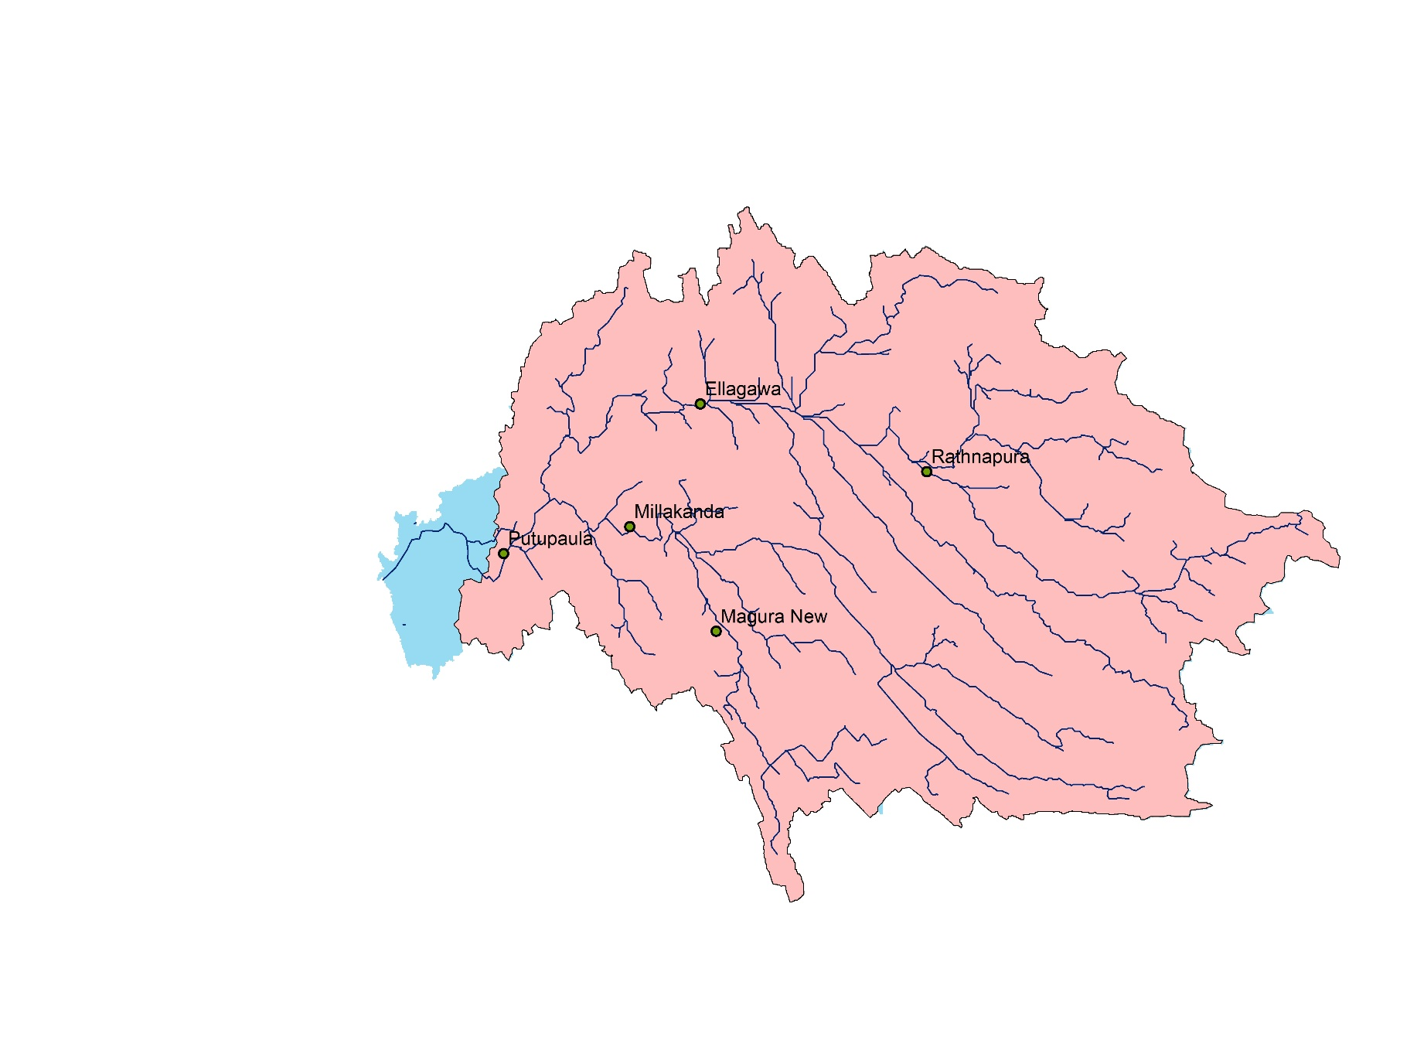
Putupaula Catchment
Catchment Area - 2816 km²
Annual Rainfall - 3200 mm

